Slide 1
WAQS Monitoring Network Assessment
IWDW-WAQS Governing Board
May 5, 2017

Slide 2
WAQS Monitoring Network Assessment
Outline (from 2017 WAQS Monitoring Network Report -Draft)
Executive Summary
Objectives
Tasks
Agency Participation
Network Status
Airsheds
Correlation Analysis (monitor-to-monitor analysis)
Area Served Analysis (monitor spatial extents)
Gap Analysis
Emissions Analysis
Recommendations
Next Steps
Additional Resources

Slide 3
WAQS Monitoring Network Assessment
Objectives
Provide adequate spatial coverage of study area;
Monitor locations downwind of existing or planned future oil and gas development areas;
Monitor Air Quality Related Values impacts on Class I and sensitive Class II areas;
Characterize background O3;
Provide data, including O3, PM and precursor measurements, to support model performance evaluation;
Assess potential impacts of oil and gas development on rural population areas;
Incorporate WAQS emissions in area served and gap analysis;
Provide recommendations for modifications to monitoring network configuration.

Slide 4
WAQS Monitoring Network Assessment
Correlation Analysis
Goal: Identify overserved area
Criteria: Select monitor pairs with R2>=0.8 and mass difference < 10%
Agnostic to airshed boundaries
Summary
O3 – identified >50 correlated monitors in both urban areas and O&G development regions;
NO2 – identified correlated monitors in Denver County, Uinta Basin, and near Sinclair Refinery in WY (mass difference < 13%);
PM2.5FRM – correlated monitors primarily in Wasatch Front and NFR;
PM2.5nonFRM/O3 – identified highly correlated IMPROVE/IMPORVE Protocol monitors;
Detail map shows correlated NO2, O3 and PM2.5 monitors in Uinta and San Juan basins.

Slide 5
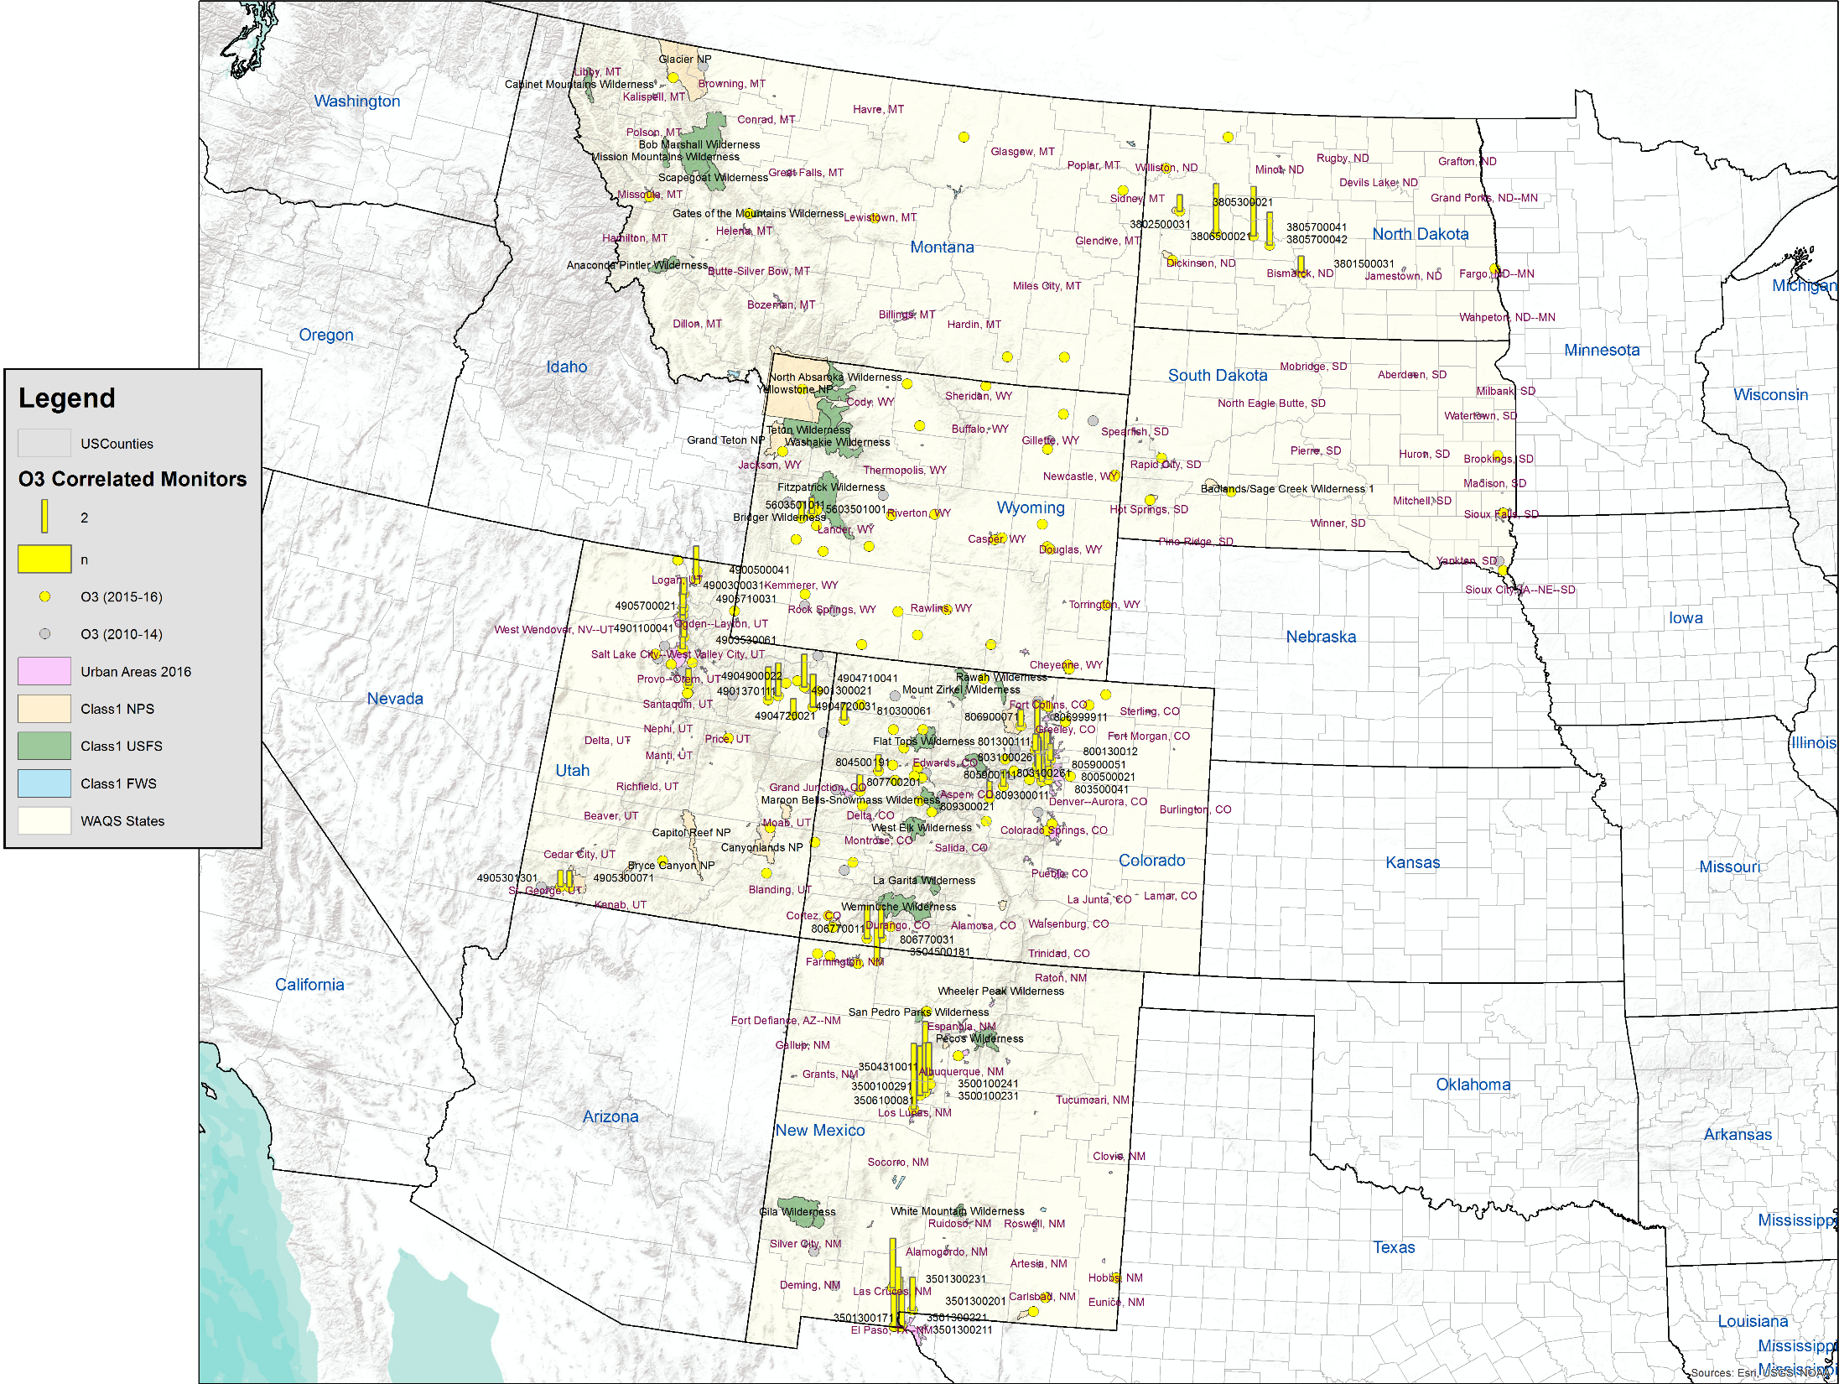
WAQS Monitoring Network Assessment
Notes:
Correlation analysis map for O3. Bars show number of sites correlated at R2>=0.8, average concentration within 10%

Slide 6
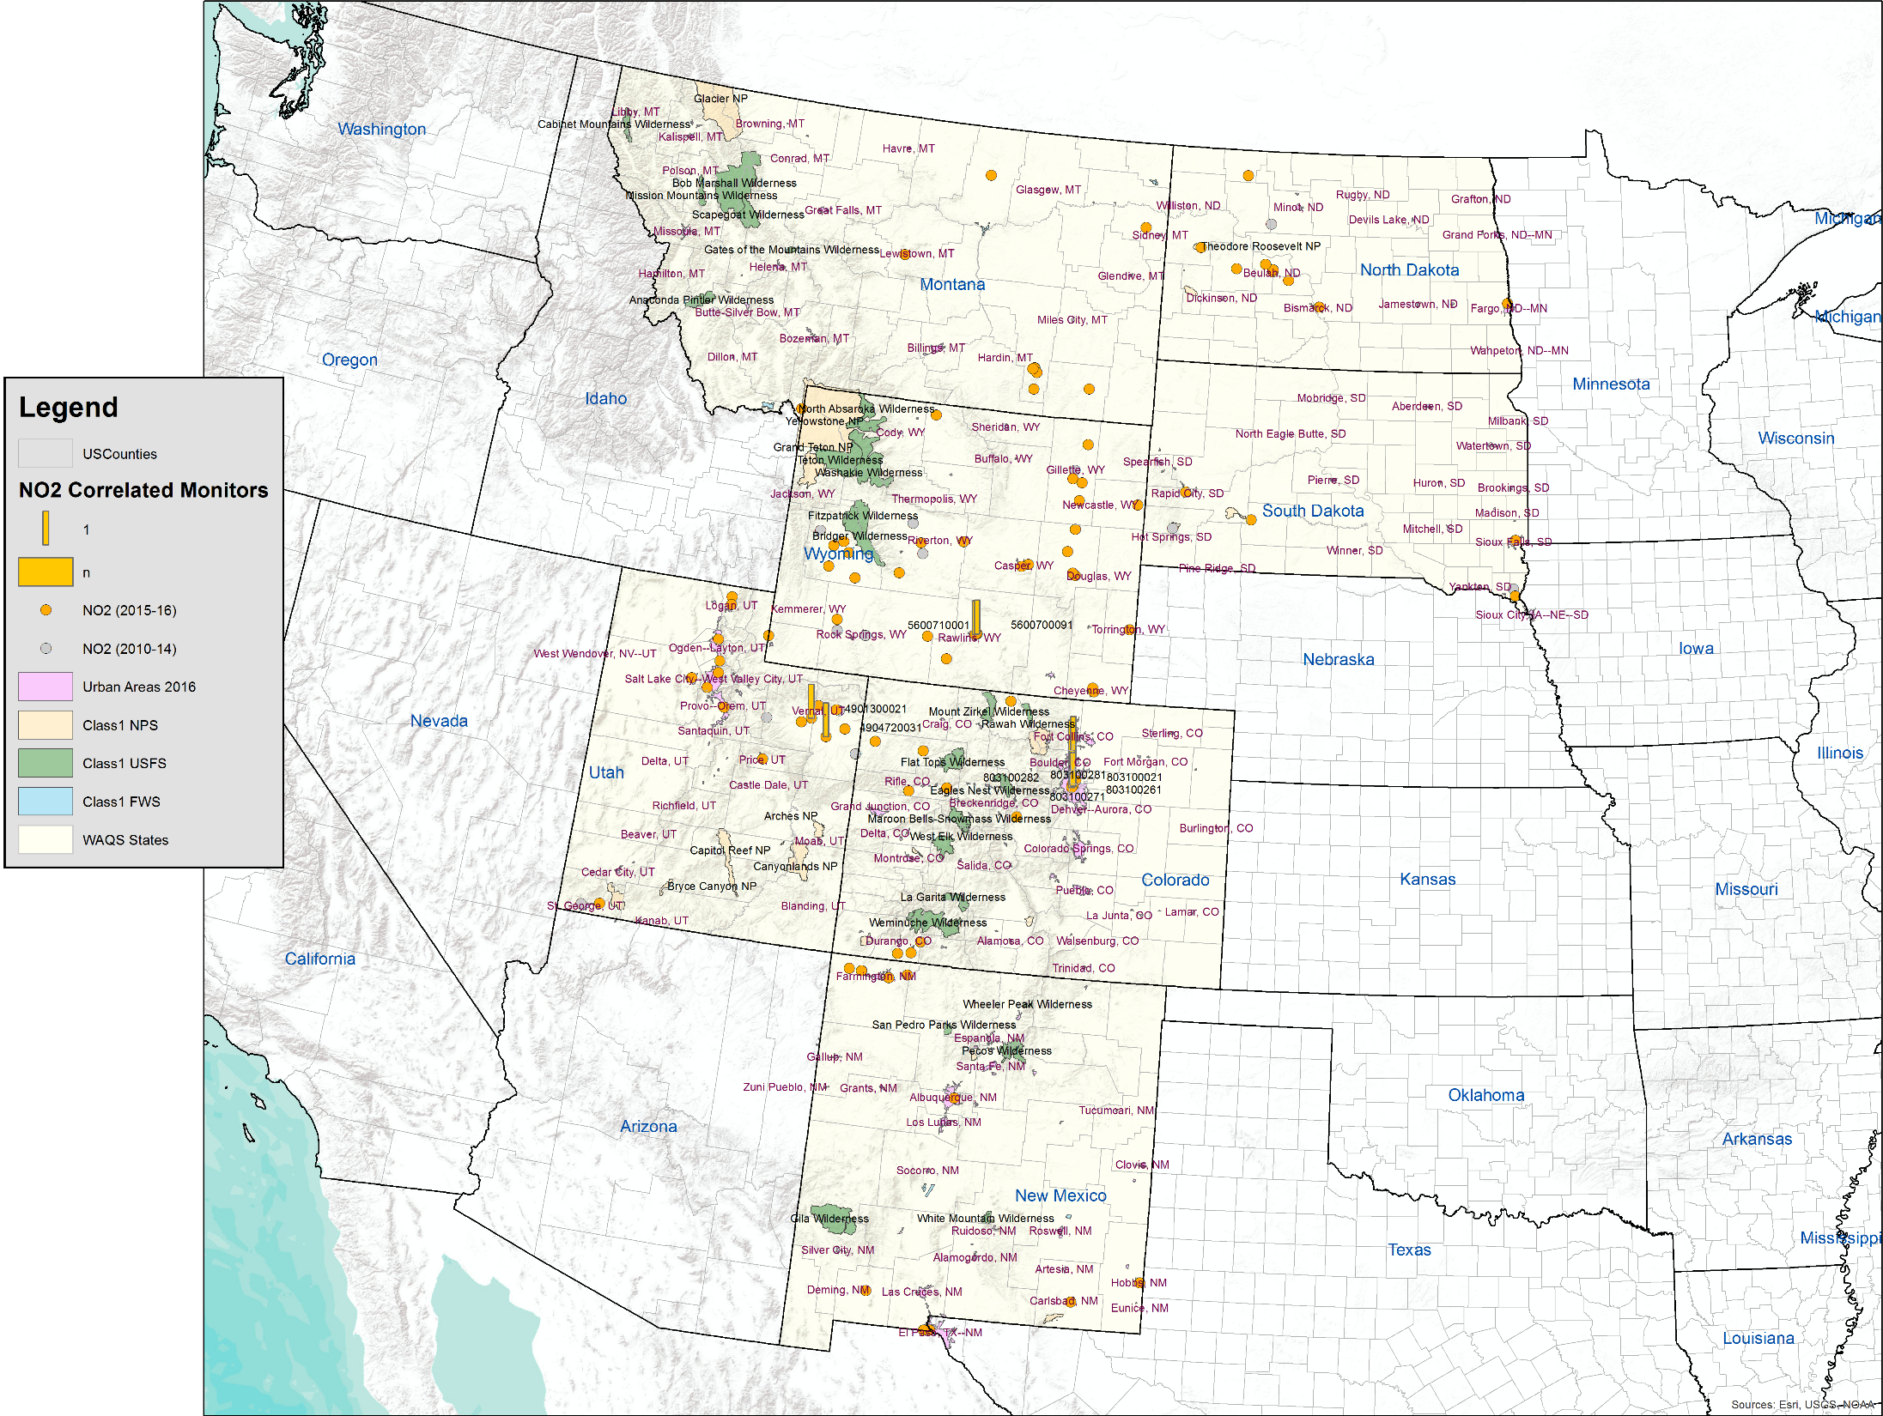
WAQS Monitoring Network Assessment
Notes:
Correlation analysis map for NO2. Bars show number of sites correlated at R2>=0.8, average concentration within 13%

Slide 7
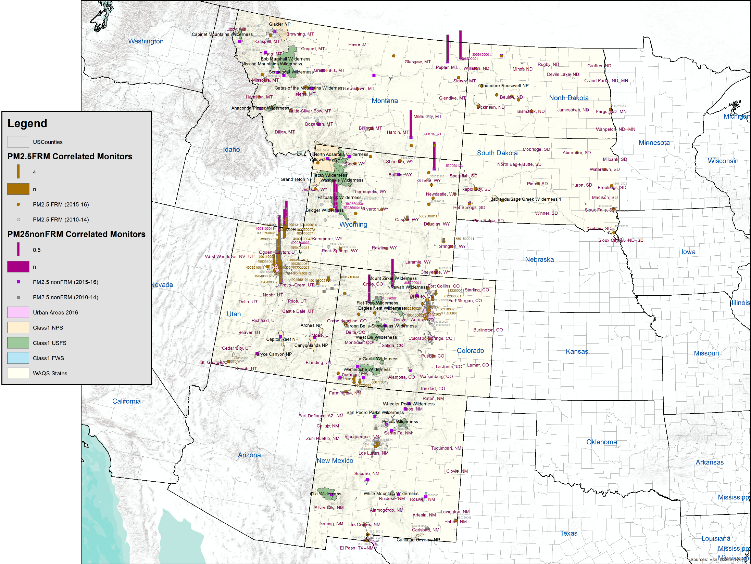
WAQS Monitoring Network Assessment
Notes:
Correlation map for PM2.5. Bars show number of sites correlated at R2>=0.8, average concentration within 10%

Slide 8
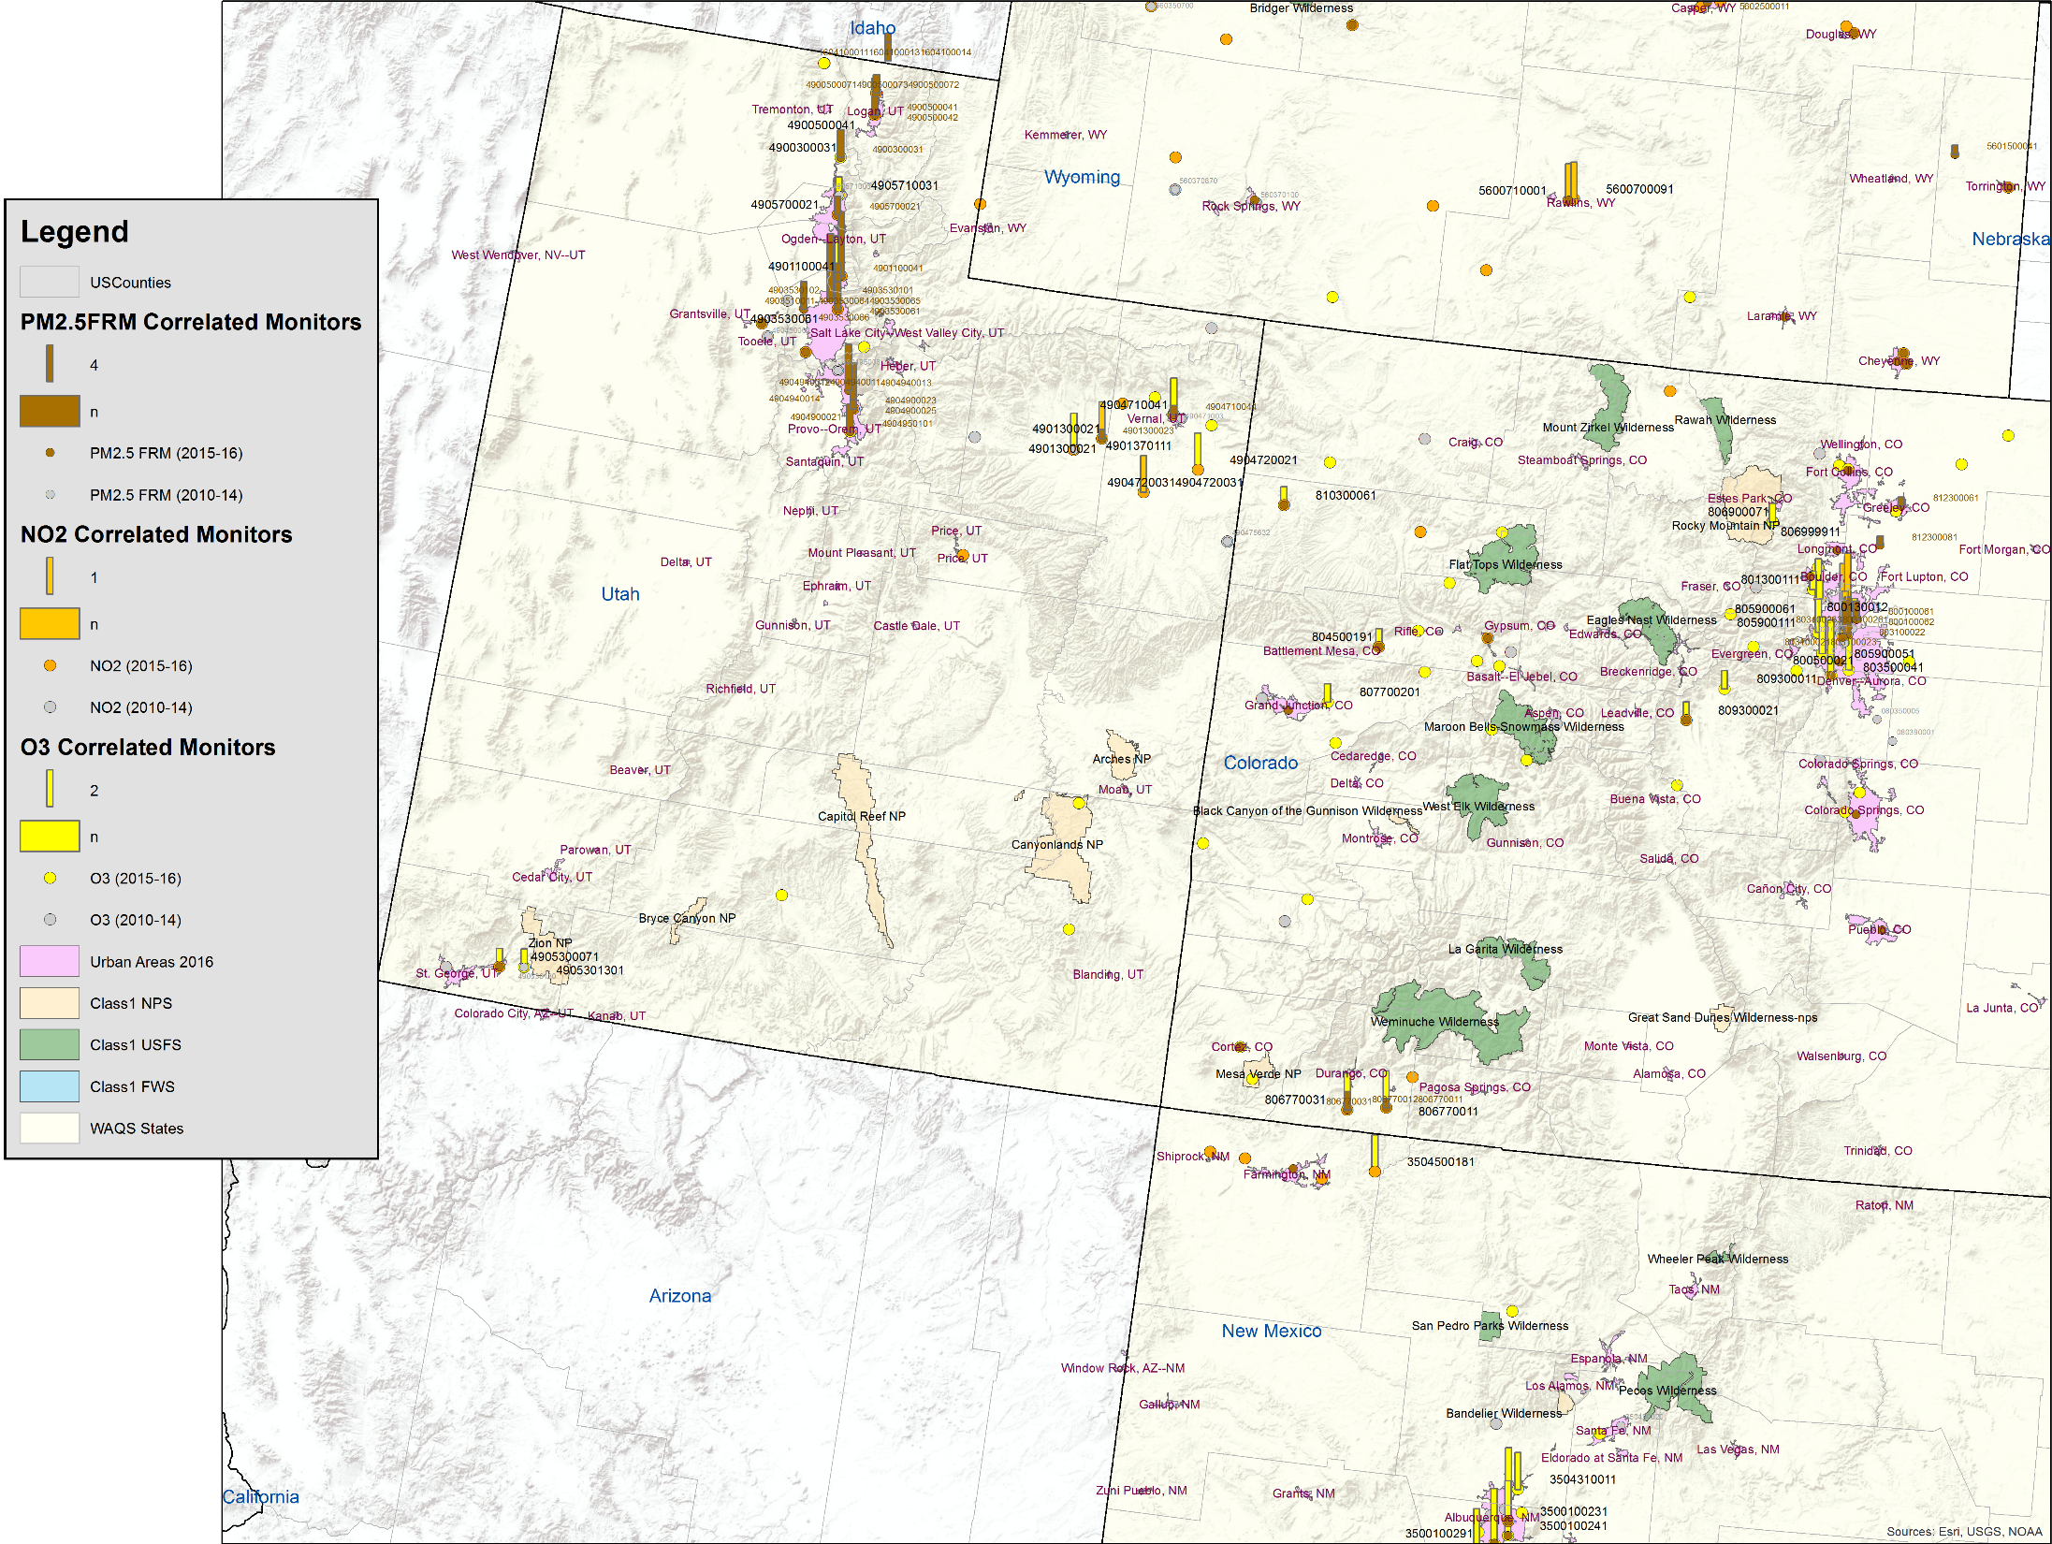
WAQS Monitoring Network Assessment
Notes:
Correlation map for multiple parameters. Bars show number of sites correlated at R2>=0.8,

Slide 9
WAQS Monitoring Network Assessment
Area Served and Gap Analysis
Goal: Identify underserved areas
Method: Examine maps of monitored areas with emissions proxy overlays
Incorporates airshed, Thiessen polygon and monitor spatial extents
Key recommendations
Add O3 monitoring in Wyoming Powder River Basin and near Laramie (corroborated by WDEQ);
Address dearth of NO2 monitoring in and downwind of DJ Basin; possibly add VOC monitoring to address health effects, public safety, benefit MPE;
Add O3 monitors to serve rural communities in Eastern Colorado, possibly identify additional NAAs;
Conduct O3 monitoring to establish O3 baseline for Trinidad, Colorado;
Redistribute O3 monitors from overserved basins (e.g. Roaring Fork/Glenwood basin has eight O3 active monitors and Grand Junction/Delta County basin has one);
Add O3 & NO2 monitoring in north central Montana;
Additional recommendations in report.

Slide 10
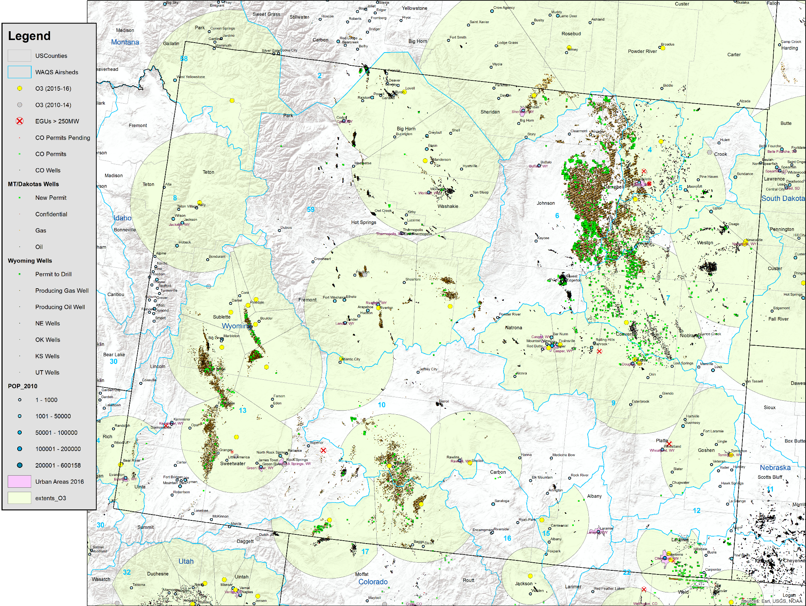
WAQS Monitoring Network Assessment
Notes:
Recent O&G well layer from WOGCC

Slide 11
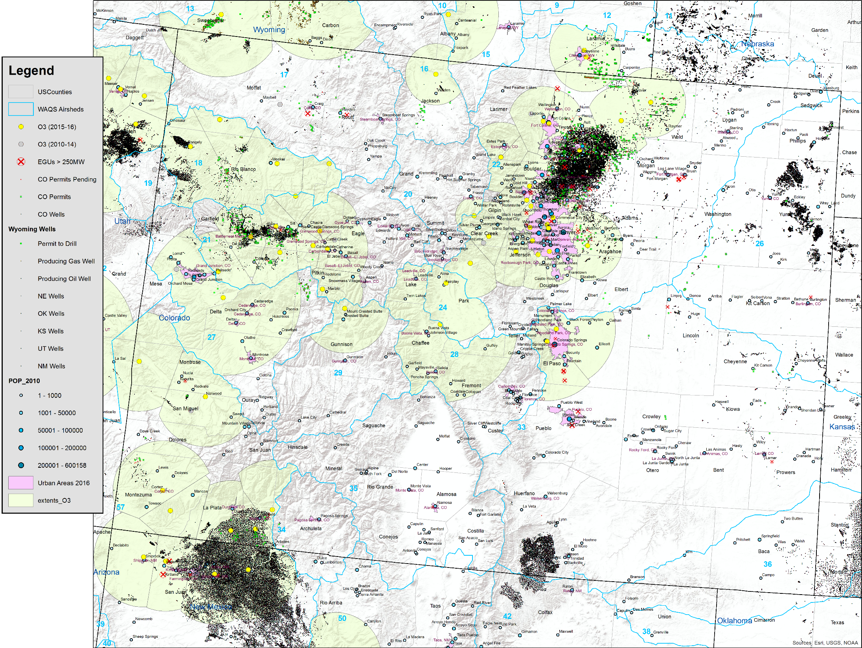
WAQS Monitoring Network Assessment
Notes:
Possible addition of monitor on W. side of McClure pass. Note that basin 21 has eight O3 monitors and basin 27 has one O3 monitor

Slide 12
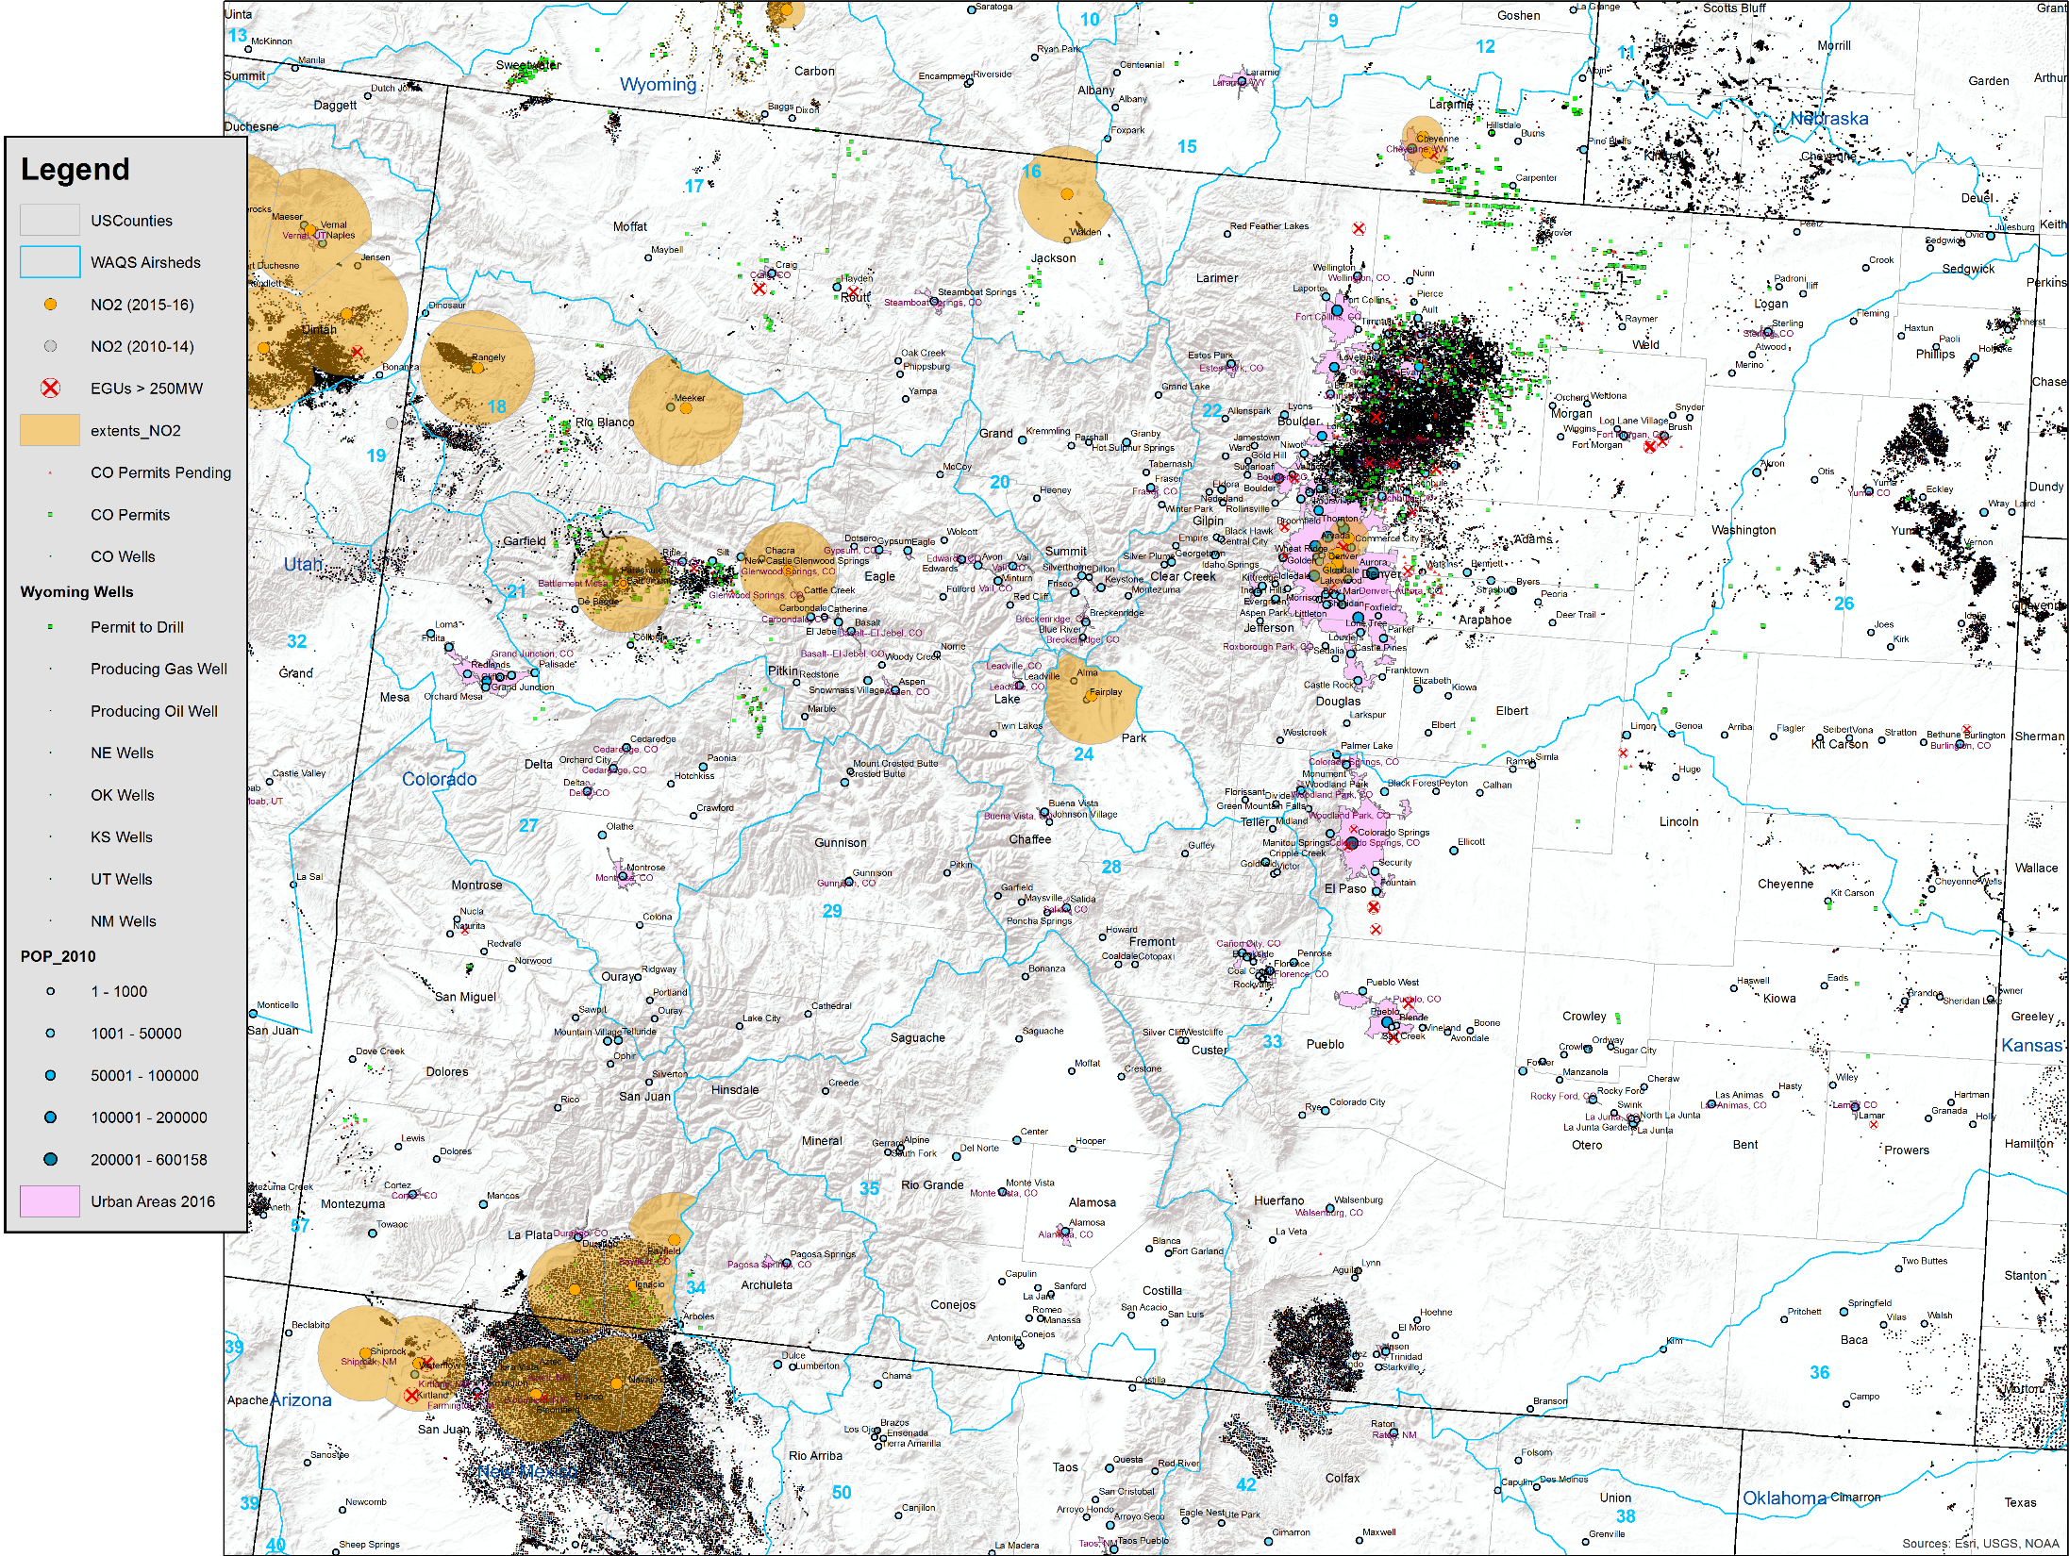
WAQS Monitoring Network Assessment

Slide 13
WAQS Monitoring Network Assessment
Emissions Analysis
Goal: Corroborate area served and gap analysis, rank monitors by represented emissions magnitude
Method: Use WAQS 2011b v2 12km O&G sector emissions; process VOC, NMHC, NOx, FP parameters
Incorporates airshed and monitor spatial extent analysis; pairs VOC parameter with O3 monitor spatial extents, NOx with NO2 monitor spatial extents;
Ranks monitors by value in representing O&G emission sectors (colored spatial extents)
Identifies monitors with little or no representation of O&G emission sectors (cross hatched spatial extents)
Summary
2011b v2 emissions include Williston and Great Plains inventories;
Corroborates recommendations from gap analysis identifying NO2 monitoring gaps in and downwind of DJ Basin;
Highlights that there are no NO2 monitors in Colorado east of the Continental Divide that characterize O&G emissions;
Indicates high value monitors in O&G development regions;
Useful for MPE to identify monitors not influenced by O&G emissions.

Slide 14
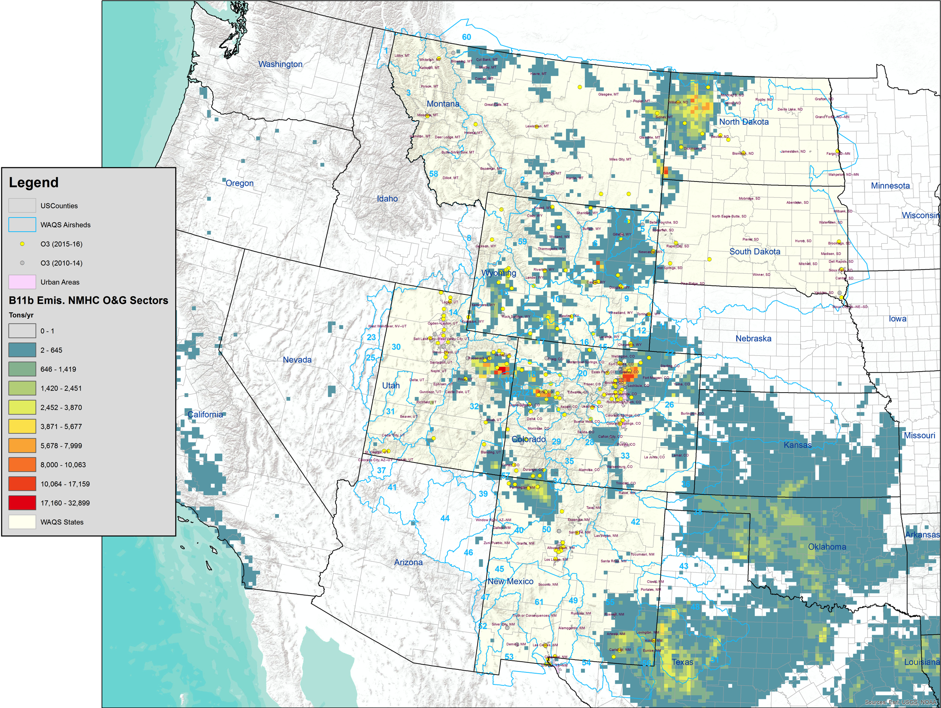
WAQS Monitoring Network Assessment
Notes:
NMHC is VOC parameters without ECH4

Slide 15
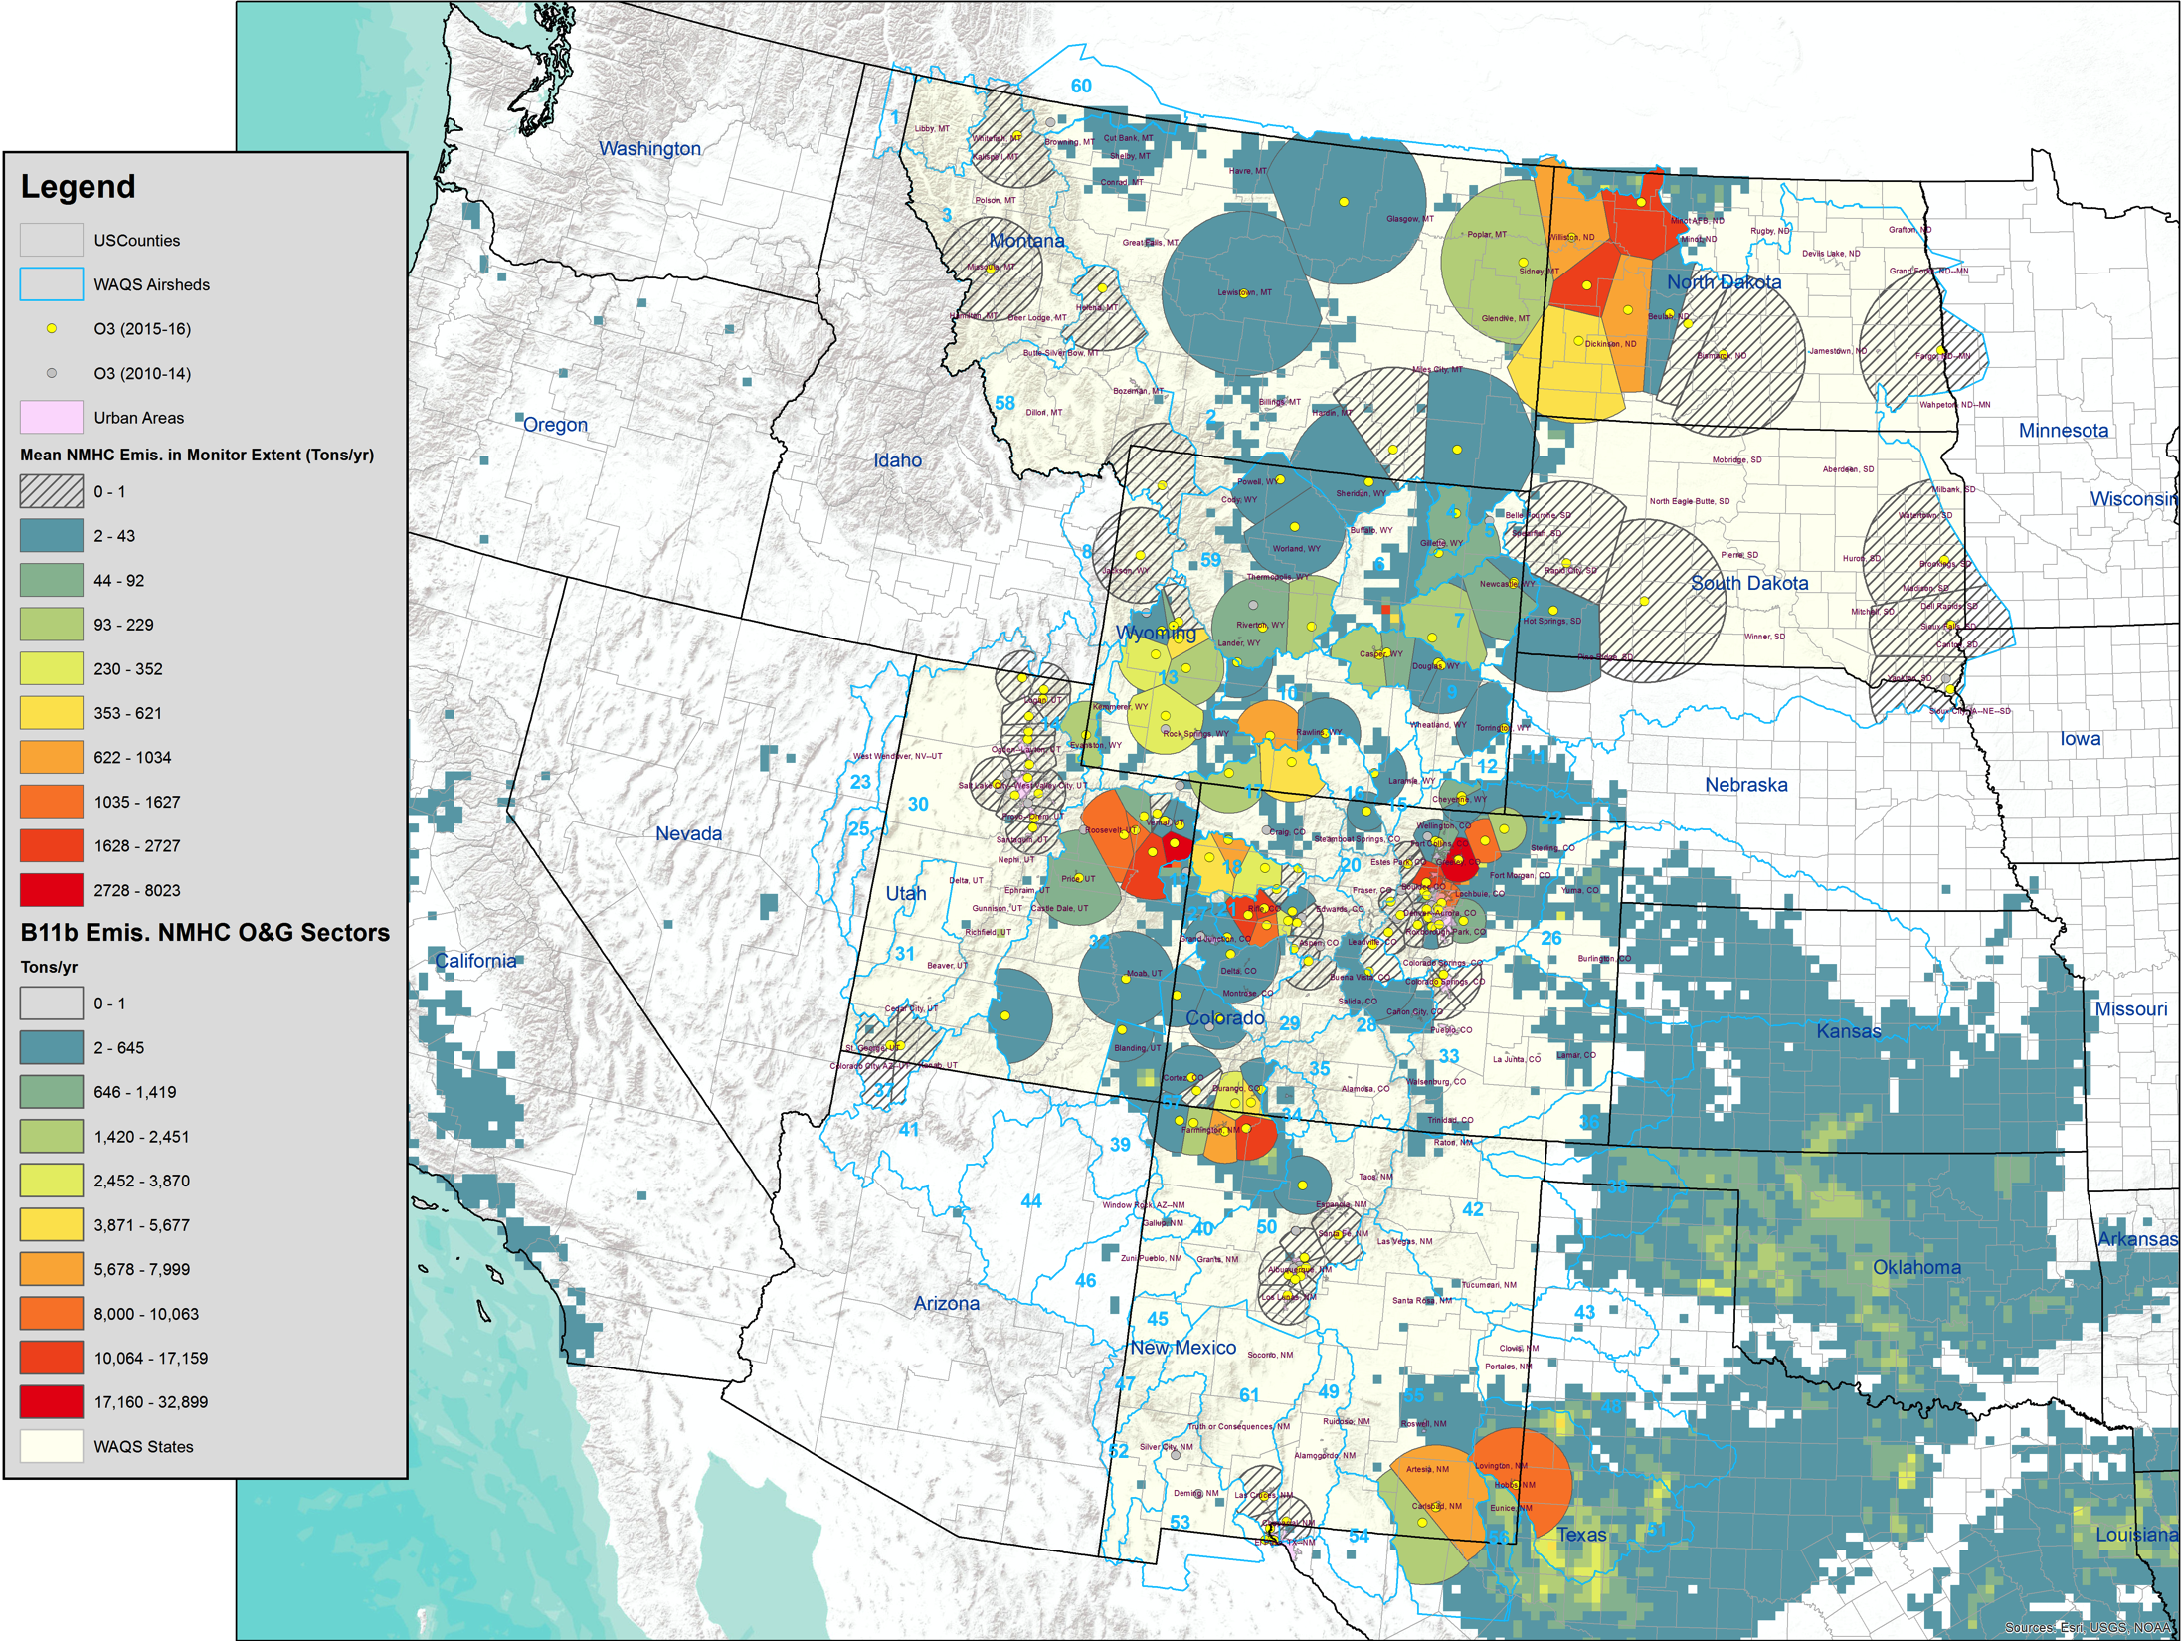
WAQS Monitoring Network Assessment

Slide 16
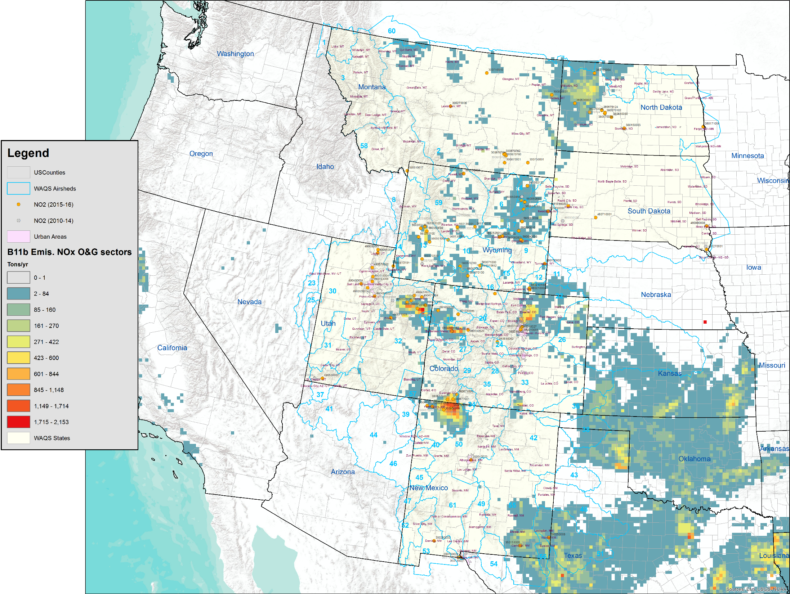
WAQS Monitoring Network Assessment

Slide 17
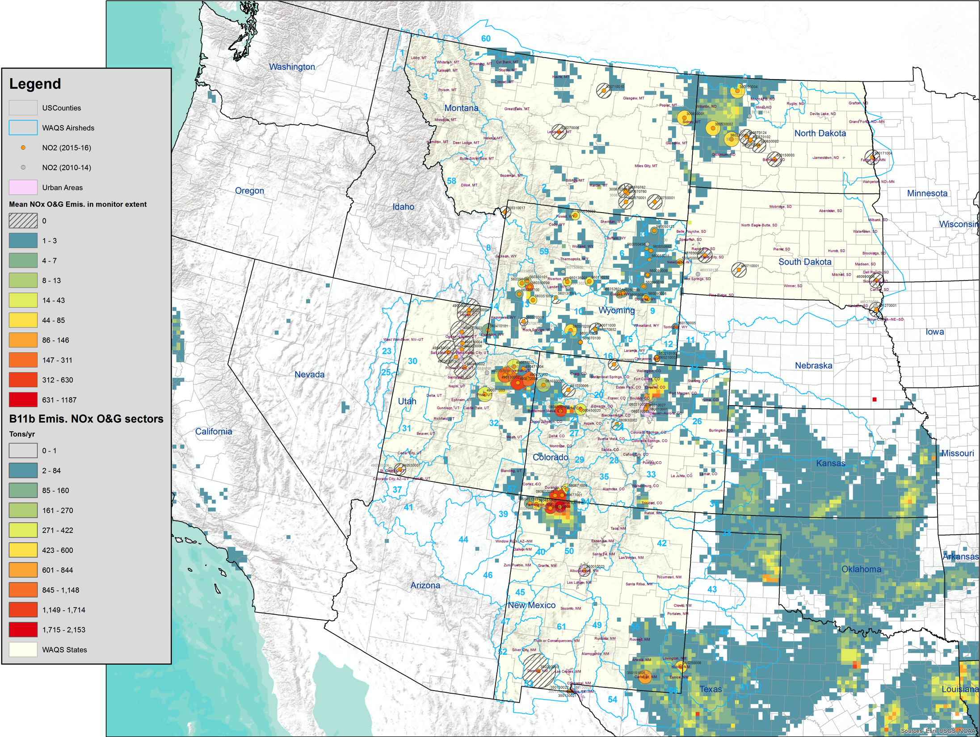
WAQS Monitoring Network Assessment

Slide 18
WAQS Monitoring Network Assessment
Additional Resources
WAQS Monitoring Network Assessment wiki
Monitors – maps and tabular data; identifies organizations, networks, input form Working Group agency reps.
Current conditions (2015 annual averages, 2013-2015 DVs)
Correlation analysis
Representative area and gap analysis
Emissions analysis
2015 WAQS Monitoring Network Report - Draft

